Slide 1



CS
VEHICLE REPAIR HUB
ENHANCING UX IN VEHICLE MAINTENANCE AND REPAIR

Slide 2

OUR TEAM
AAGHASH M
CHANDRU K T
LAKSHIN S
SRIVATHSAN K

Slide 3
Current Problem
1. Have to go to shops directly
2. No Proper Updates on vehicles
3. Wait long hours on Service shops
4. Difficult to find shops
5. No Proper Guides

Slide 4
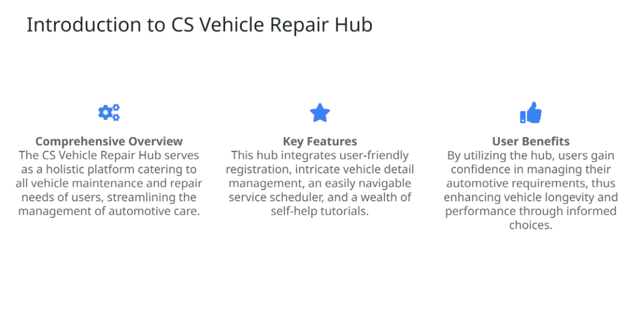
OVERVIEW

Slide 5
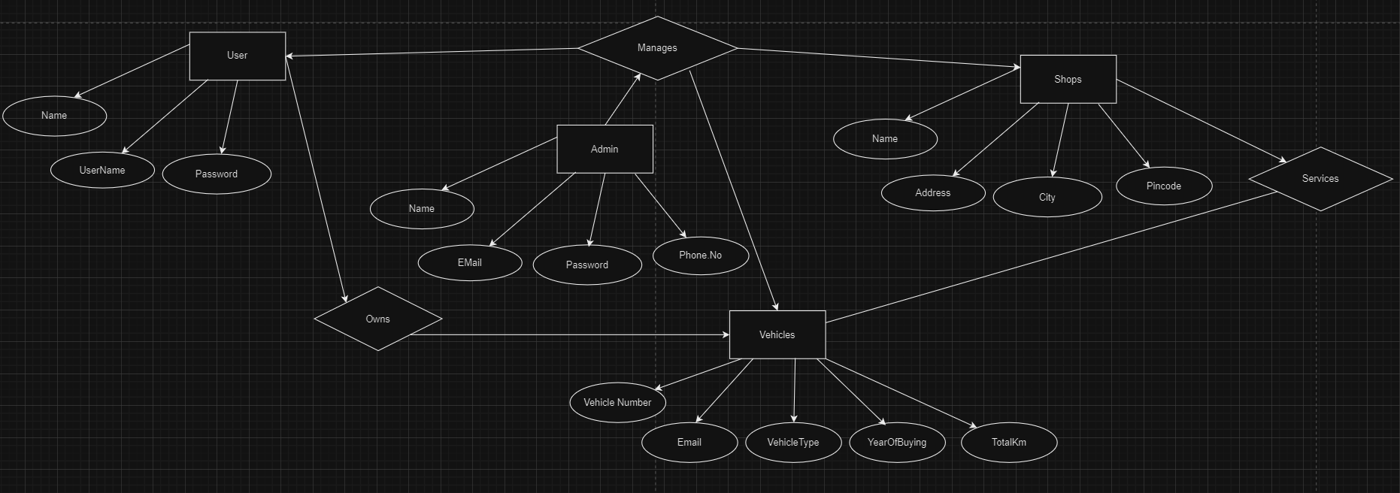
ER DIAGRAM

Slide 6

TECH STACK
• Modern Frontend Technologies: The use of React and CSS enables the development of a responsive,modern user interface that enhances the user experience significantly.
• Powerful Backend Infrastructure: Spring Boot serves
as the backbone, managing server-side processing and
business logic effectively, ensuring robustness and
Performance, AXIOS
• Reliable Data Management: MySQL provides a reliable
and efficient database solution for storing user
information, vehicle data, and service records.
• YouTube API Integration: Integration of YouTube's API
facilitates seamless access to video tutorials, enriching
the user experience with multimedia resources.

Slide 7
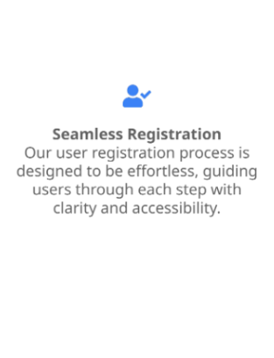
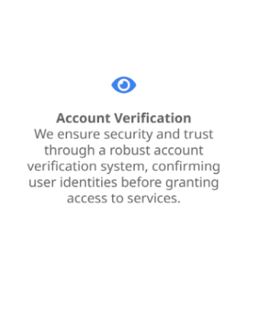
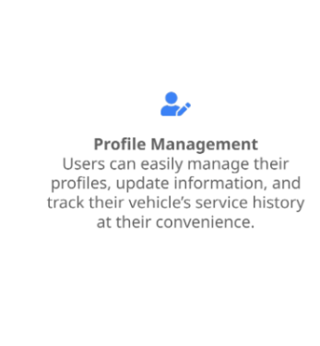
USER REGISTRATION

Slide 8
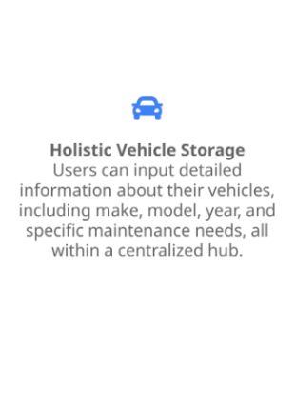
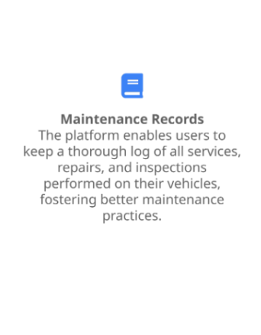
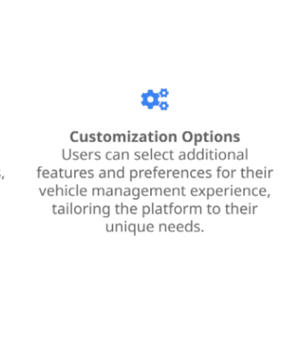
VEHICLE DETAILS MANAGEMENT

Slide 9
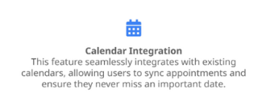
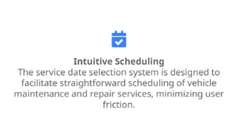
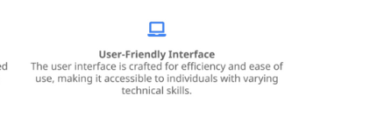
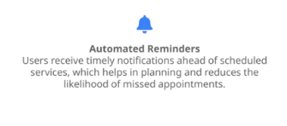
SERVICE BOOKING

Slide 10
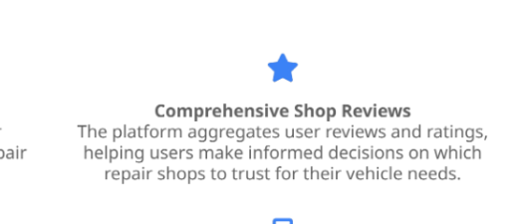
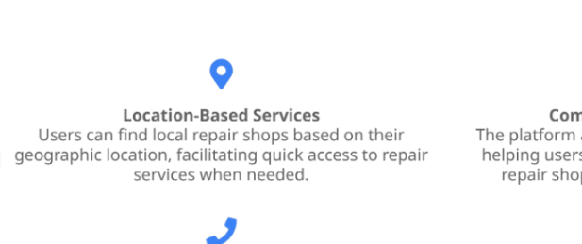
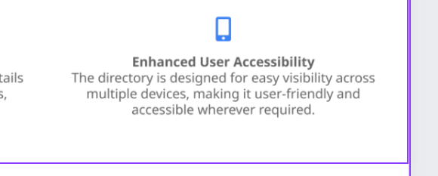
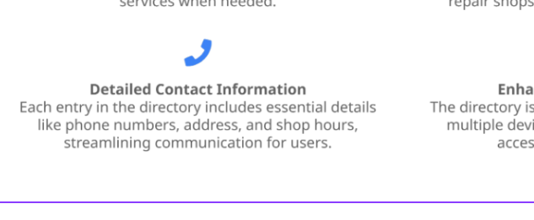
DIRECTORY OF SHOPS

Slide 11

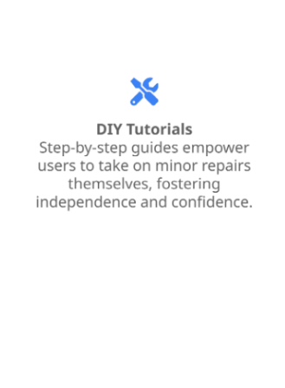
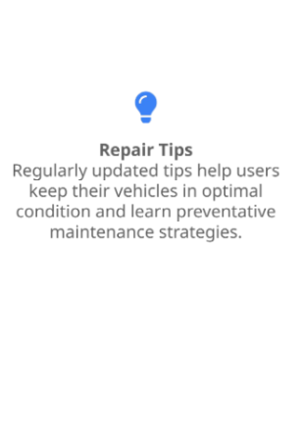
INFORMATIVE GUIDES

Slide 12

EMPOWERING WITH TIPS
• Essential Maintenance Tips: Regular maintenance
tips provided help users uphold vehicle health,
potentially preventing costly repairs in the long run.
• Actionable Troubleshooting Guides: Users gain
access to troubleshooting guides that enable them
to quickly address minor vehicle problems with
confidence.
• Proactive Prevention Strategies: Advice centered
on proactive measures, such as regular check-ups
and monitoring fluid levels, empowers users to
manage their vehicles effectively.
• Building User Confidence: By equipping users with
knowledge. the platform fosters confidence in
handling their vehicle's maintenance issues
independently.

Slide 13


ADMIN DASHBOARD
• User Management Features: The admin
dashboard provides robust tools for managing
user data, permissions, and settings, ensuring
optimal platform operation.
• Role Permissions Administration: Flexibility to
assign specific roles and permissions enhances
the security and organization of operations on
the platform.
• Data Analysis and Insights: The dashboard
allows for tracking user interactions and system
performance, facilitating data.driven decision.
making for service improvements.

Slide 14

THANK YOU

